Slide 1


Department of Information Technology
BVRIT HYDERABAD College of Engineering for Women
LIQUID LEVEL MONITORING AND OVERFLOW PREVENTION SYSTEM USING IoT FOR VISUALLY IMPAIRED
Team- 15
V. Bhargavi(1271)
P. Revathi(1274)
V. Madhuri(LE-1209)
P. Meghana(LE-1212)
Under the Guidance of
Ms. Ch. Sai Lalitha Bala
Assistant Professor

Slide 2

Contents
Summary of Stage-1
Implementation
Modules
Functionality
Conclusion (Work pending)

Slide 3
Summary of Stage-1
The main aim of the project is to assist the visually impaired individuals by monitoring and detecting the level and temperature of the liquid in a container with a voice assistance.
So in stage 1 we are done with detecting temperature and displaying it on the LCD screen provided.
It gives the assistance through speaker whether the liquid is hot or cold.

Slide 4
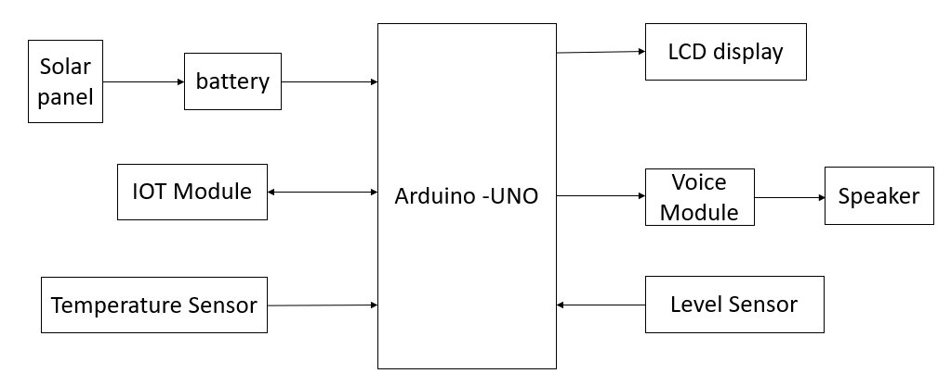
Implementation
System Architecture

Slide 5
Modules
SENSING MODULE
Level Sensor
Temperature Sensor
VOICE MODULE
POWER MODULE

Slide 6
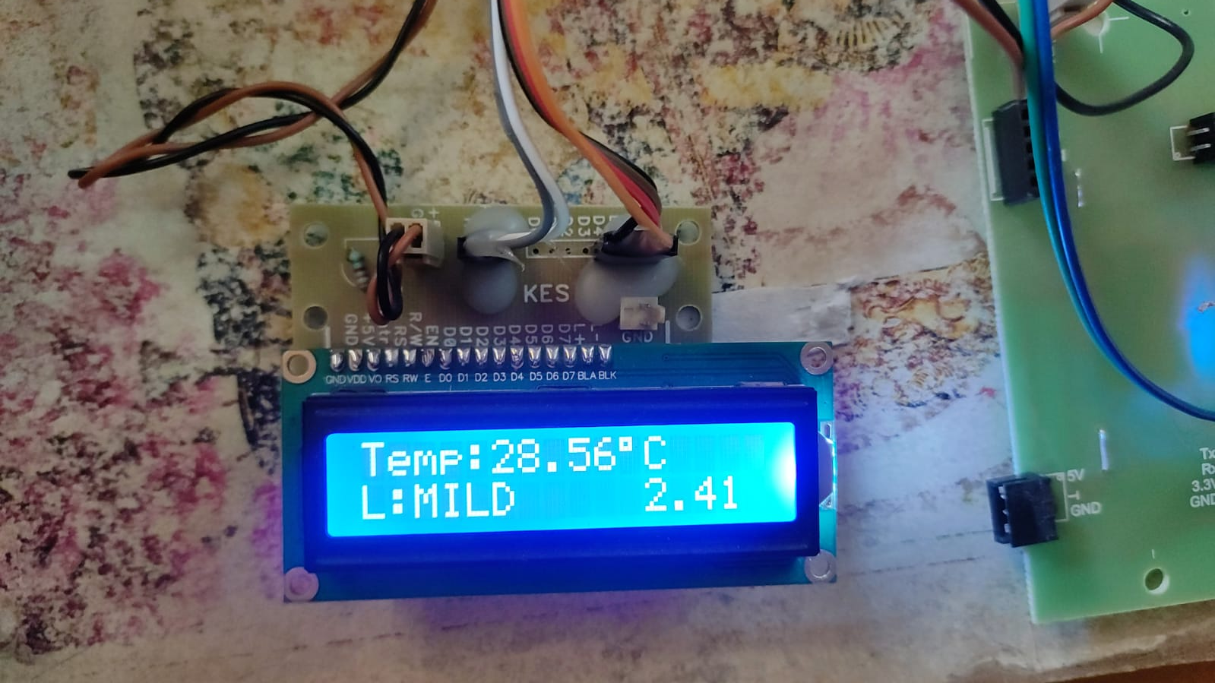
Functionality
Sensing module
Temperature sensor

Slide 7
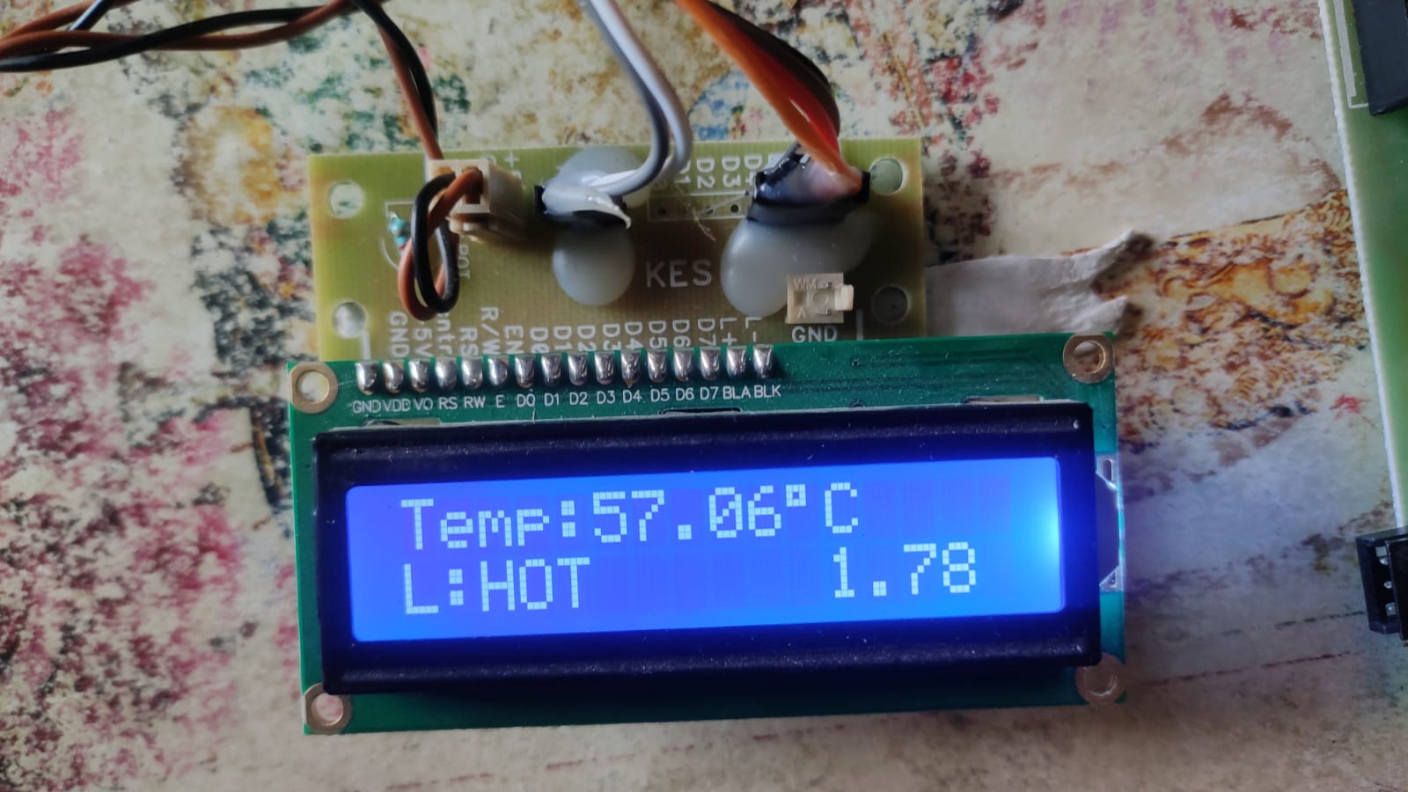
Functionality
2. Level sensor

Slide 8
Conclusion-(Work pending)
Our project is based on the detection of temperature and the level of liquid in order to assist the visually impaired through voice. We summarized the project and we are working on the battery.

Slide 9


